Slide 1
Orthogonal Matrices & Symmetric Matrices
Hung-yi Lee

Slide 2
Outline
Orthogonal Matrices
Reference: Chapter 7.5
Symmetric Matrices
Reference: Chapter 7.6

Slide 3
Orthogonal Matrix
An nxn matrix Q is called an orthogonal matrix if the columns of Q are orthonormal.
Orthogonal operator: standard matrix is an orthogonal matrix.
unit
unit
is an orthogonal matrix.
orthogonal

Slide 4

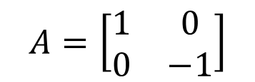
Norm-preserving
A linear operator is norm-preserving if
$$\left\|T\left(u\right)\right\|=\left\|u\right\|$$
For all u
Example: linear operator T on R² that rotates a vector by θ.
⇒ Is T norm-preserving?
Example: linear operator T is reflection
⇒ Is T norm-preserving?
$$A=\left[\begin{matrix}1 & 0 \\ 0 & −1\end{matrix}\right]$$
Notes:
Anything in Common?

Slide 5
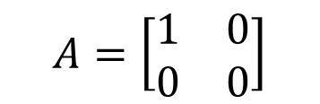
Norm-preserving
A linear operator is norm-preserving if
$$\left\|T\left(u\right)\right\|=\left\|u\right\|$$
For all u
Example: linear operator T is projection
⇒ Is T norm-preserving?
$$A=\left[\begin{matrix}1 & 0 \\ 0 & 0\end{matrix}\right]$$
Example: linear operator U on R^{n} that has an eigenvalue λ ≠ ±1.
⇒ U is not norm-preserving, since for the corresponding
eigenvector v, ||U(v)|| = ||λv|| = |λ|·||v|| ≠ ||v||.

Slide 6
Norm-preserving
Necessary conditions:
Norm-preserving
Orthogonal Matrix
?
???
Linear operator Q is norm-preserving
||q_{j}|| = 1
||q_{j}|| = ||Qe_{j}|| = ||e_{j}||
q_{i} and q_{j} are orthogonal
畢式定理
||q_{i} + q_{j}||² = ||Qe_{i} + Qe_{j}||² = ||Q(e_{i} + e_{j})||² = ||e_{i} + e_{j}||² = 2 = ||q_{i}||² + ||q_{j}||²
Notes:
Why there is no northonormal matrix??????????????????????????????????????????????????????

Slide 7
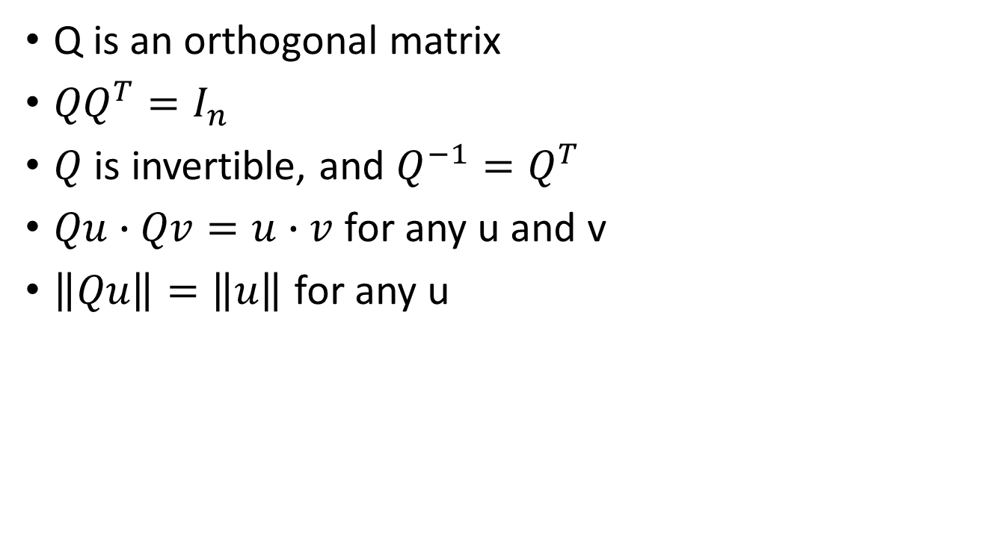
Orthogonal Matrix
Those properties are used to check orthogonal matrix.
Q is an orthogonal matrix
${QQ}^{T}=I_{n}$
$Q$ is invertible, and $Q^{−1}=Q^{T}$
$Qu∙Qv=u∙v$ for any u and v
$\left\|Qu\right\|=\left\|u\right\|$ for any u
Simple inverse
Q preserves dot projects
Q preserves norms
Norm-preserving
Orthogonal Matrix
Notes:
Proof (b) ⬄ (c) By definition of invertible matrices
(a) ⇒ (b) with Q = [ q₁ q₂ ☹ q_{n} ], q_{i} • q_{i} = 1 = [Q^{T}Q]_{ii} ∀i,
and q_{i} • q_{j} = 0 = [Q^{T}Q]_{ij} ∀i ≠ j.
⇒ Q^{T}Q = I_{n}
(c) ⇒ (d) ∀u, v ∈ R^{n}, Qu • Qv = u • Q^{T}Qv = u • Q⁻¹Qv = u • v.
(d) ⇒ (e) ∀u ∈ R^{n}, ||Qu|| = (Qu • Qu)^{1/2} = (u • u)^{1/2} = ||u||.
(e) ⇒ (a) The above necessary conditions.

Slide 8


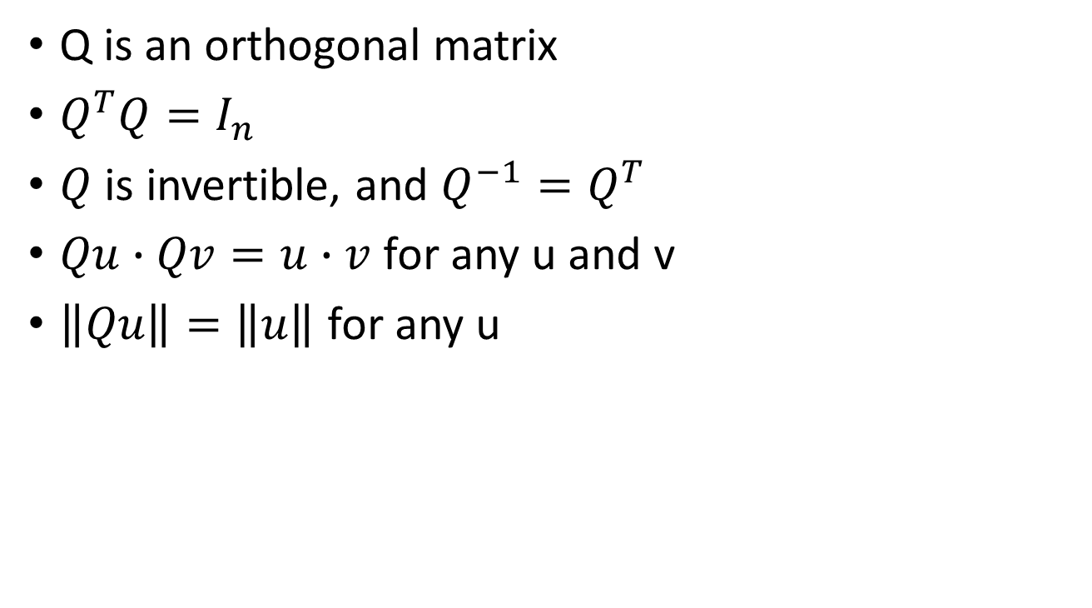


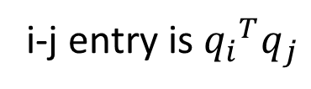









Orthogonal Matrix
1
$$q_{i}∙q_{j}={q_{i}}^{T}q_{j}$$
1
Q is an orthogonal matrix
$Q^{T}Q=I_{n}$
$Q$ is invertible, and $Q^{−1}=Q^{T}$
$Qu∙Qv=u∙v$ for any u and v
$\left\|Qu\right\|=\left\|u\right\|$ for any u
$$i≠j: 0$$
2
$$i=j: 1$$
$$Q^{T}Q$$
3
i-j entry is ${q_{i}}^{T}q_{j}$
2
$$Qu∙Qv={\left(Qu\right)}^{T}Qv$$
$$=u^{T}Q^{T}Qv$$
$$=u^{T}Iv$$
$$=u^{T}v$$
$$=u∙v$$
3
$$Qu∙Qv=u∙v$$
$$Qu∙Qu=u∙u$$
$${\left\|Qu\right\|}^{2}={\left\|u\right\|}^{2}$$
$$\left\|Qu\right\|=\left\|u\right\|$$
Notes:
Proof (b) ⬄ (c) By definition of invertible matrices
(a) ⇒ (b) with Q = [ q₁ q₂ ☹ q_{n} ], q_{i} • q_{i} = 1 = [Q^{T}Q]_{ii} ∀i,
and q_{i} • q_{j} = 0 = [Q^{T}Q]_{ij} ∀i ≠ j.
⇒ Q^{T}Q = I_{n}
(c) ⇒ (d) ∀u, v ∈ R^{n}, Qu • Qv = u • Q^{T}Qv = u • Q⁻¹Qv = u • v.
(d) ⇒ (e) ∀u ∈ R^{n}, ||Qu|| = (Qu • Qu)^{1/2} = (u • u)^{1/2} = ||u||.
(e) ⇒ (a) The above necessary conditions.

Slide 9




Orthogonal Matrix
Let P and Q be n x n orthogonal matrices
$detQ=±1$
$PQ$ is an orthogonal matrix
$Q^{−1}$ is an orthogonal matrix
$Q^{T}$ is an orthogonal matrix
Check by ${\left(PQ\right)}^{−1}={\left(PQ\right)}^{T}$
Check by ${\left(Q^{−1}\right)}^{−1}={\left(Q^{−1}\right)}^{T}$
=
Proof (a) QQ^{T} = I_{n} ⇒ det(I_{n}) = det(QQ^{T}) = det(Q)det(Q^{T})
= det(Q)² ⇒ det(Q) = ±1.
(b) (PQ)^{T} = Q^{T}P^{T} = Q⁻¹P⁻¹ = (PQ)⁻¹.
(C) (Q⁻¹)⁻¹ = (Q^{T})⁻¹ = (Q⁻¹)^{T}
Rows and columns

Slide 10
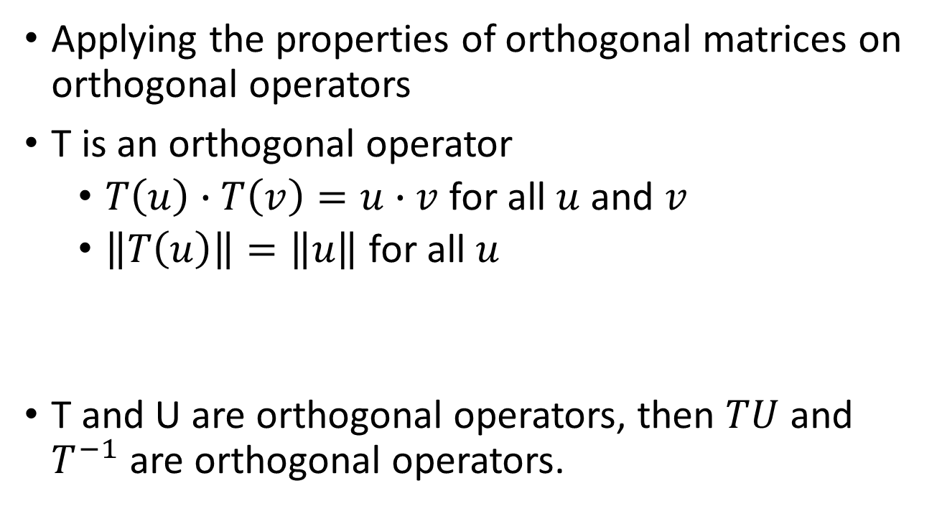
Orthogonal Operator
Applying the properties of orthogonal matrices on orthogonal operators
T is an orthogonal operator
$T\left(u\right)∙T\left(v\right)=u∙v$ for all $u$ and $v$
$\left\|T\left(u\right)\right\|=\left\|u\right\|$ for all $u$
T and U are orthogonal operators, then $TU$ and $T^{−1}$ are orthogonal operators.
Preserves dot product
Preserves norms

Slide 11
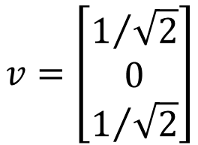
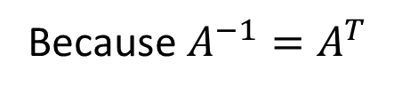
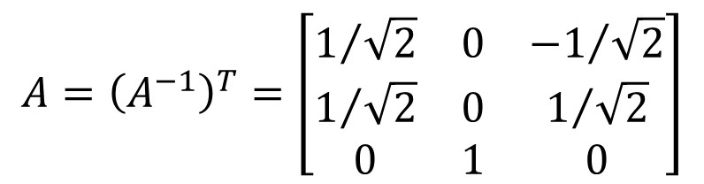

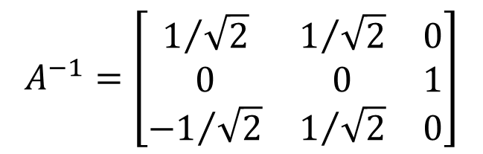


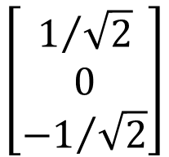


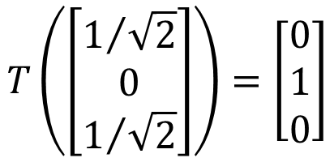
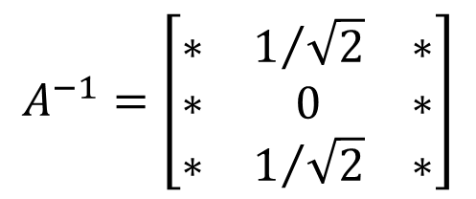
Example: Find an orthogonal operator T on R³ such that
$$T\left(\left[\begin{matrix}1/{\sqrt{2}} \\ 0 \\ 1/{\sqrt{2}}\end{matrix}\right]\right)=\left[\begin{matrix}0 \\ 1 \\ 0\end{matrix}\right]$$
Norm-preserving
$$v=\left[\begin{matrix}1/{\sqrt{2}} \\ 0 \\ 1/{\sqrt{2}}\end{matrix}\right]$$
Find $A^{−1}$ first
$$Av=e_{2}$$
$$v=A^{−1}e_{2}$$
Because $A^{−1}=A^{T}$
$$A^{−1}=\left[\begin{matrix}∗ & 1/{\sqrt{2}} & ∗ \\ ∗ & 0 & ∗ \\ ∗ & 1/{\sqrt{2}} & ∗\end{matrix}\right]$$
Also orthogonal
$$A^{−1}=\left[\begin{matrix}1/{\sqrt{2}} & 1/{\sqrt{2}} & 0 \\ 0 & 0 & 1 \\ {−1}/{\sqrt{2}} & 1/{\sqrt{2}} & 0\end{matrix}\right]$$
$$\left[\begin{matrix}1/{\sqrt{2}} \\ 0 \\ {−1}/{\sqrt{2}}\end{matrix}\right]$$
$$\left[\begin{matrix}0 \\ 1 \\ 0\end{matrix}\right]$$
$$A={\left(A^{−1}\right)}^{T}=\left[\begin{matrix}1/{\sqrt{2}} & 0 & {−1}/{\sqrt{2}} \\ 1/{\sqrt{2}} & 0 & 1/{\sqrt{2}} \\ 0 & 1 & 0\end{matrix}\right]$$
$$1/{\sqrt{2}}x_{1}+0x_{2}+1/{\sqrt{2}}x_{3}=0$$

Slide 12
Conclusion
Orthogonal Matrix (Operator)
Columns and rows are orthogonal unit vectors
Preserving norms, dot products
Its inverse is equal its transpose

Slide 13
Outline
Orthogonal Matrices
Reference: Chapter 7.5
Symmetric Matrices
Reference: Chapter 7.6

Slide 14

Eigenvalues are real
The eigenvalues for symmetric matrices are always real.
Consider 2 x 2 symmetric matrices
How about more general cases?
$$det\left(A−tI_{2}\right)=t^{2}−\left(a+c\right)t+ac−b^{2}$$
The symmetric matrices always have real eigenvalues.

Slide 15


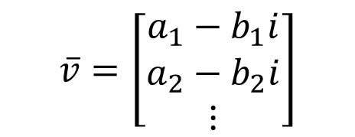




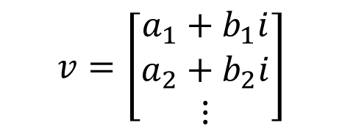
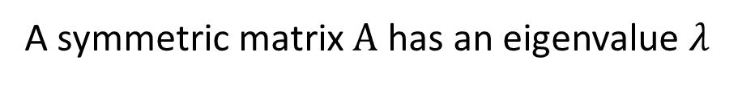







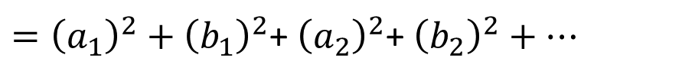






Eigenvalues are real
Symmetric matrix $A$ always has eigenvalue.
A symmetric matrix $A$ has an eigenvalue $λ$
$λ=a+bi$
$$Av=λv$$
$$\overline{Av}=\overline{λv}$$
$$\overline{A}\overline{v}=\overline{λ}\overline{v}$$
$$A\overline{v}=\overline{λ}\overline{v}$$
$$\overline{A}=A$$
$${\left(\overline{v}\right)}^{T}λv$$
$${=λ\left(\overline{v}\right)}^{T}v$$
$$v=\left[\begin{aligned}a_{1}+b_{1}i \\ a_{2}+b_{2}i \\ ⋮\end{aligned}\right]$$
$$≠0$$
$${\left(\overline{v}\right)}^{T}Av$$
$${\left(\overline{v}\right)}^{T}A^{T}v$$
$${=\left(A\overline{v}\right)}^{T}v$$
$$\overline{v}=\left[\begin{aligned}a_{1}−b_{1}i \\ a_{2}−b_{2}i \\ ⋮\end{aligned}\right]$$
$${=\left(\overline{λ}\overline{v}\right)}^{T}v$$
$${=\overline{λ}\left(\overline{v}\right)}^{T}v$$
$${\left(\overline{v}\right)}^{T}v=?$$
$$>0$$
$$λ=\overline{λ}$$
$$b=0$$
$={\left(a_{1}\right)}^{2}+{\left(b_{1}\right)}^{2}$+ ${\left(a_{2}\right)}^{2}$+ ${\left(b_{2}\right)}^{2}+…$

Slide 16










Orthogonal Eigenvectors
A is symmetric
$$det\left(A−tI_{n}\right)$$
Factorization
$$={\left(t−λ_{1}\right)}^{m_{1}}{\left(t−λ_{2}\right)}^{m_{2}}…{\left(t−λ_{k}\right)}^{m_{k}}\left(……\right)$$
Eigenvalue:
$$λ_{1}$$
$$λ_{2}$$
……
$$λ_{k}$$
Eigenspace:
$$d_{1}$$
$$≤m_{1}$$
$$d_{2}$$
$$≤m_{2}$$
……
$$d_{k}$$
$$≤m_{k}$$
(dimension)
Independent
orthogonal

Slide 17






Orthogonal Eigenvectors
A is symmetric.
If $u$ and $v$ are eigenvectors corresponding to eigenvalues $λ$ and $μ$ ($λ≠μ$)
$u$ and $v$ are orthogonal.

Slide 18






Diagonalization
$$A=PDP^{T}$$
A is symmetric
$$P^{T}AP=D$$
P is an orthogonal matrix
:
simple
D is a diagonal matrix
$$P^{T}AP=D$$
$$P^{−1}AP=D$$
$$A=PDP^{−1}$$
Diagonalization
$$A=PDP^{T}$$
P consists of eigenvectors
, D are eigenvalues
Notes:
P560

Slide 19






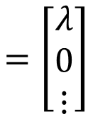

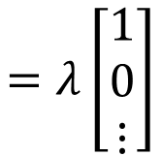



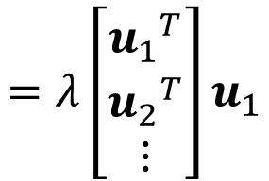




Diagonalization
A is symmetric
$$P^{T}AP=D$$
$$A:n×n$$
$A$ has eigenvalue $λ$
$$Au_{1}=λu_{1}$$
$u_{1}$ is unit vector
Find an orthonormal basis
$$\left\{u_{1},u_{2},⋯,u_{n}\right\}$$
$$=B$$
eigenvector
don’t care
by the Extension Theorem and Gram-Schmidt Process
$$B^{T}AB=?$$
$${\left(B^{T}AB\right)}^{T}=B^{T}A^{T}{\left(B^{T}\right)}^{T}=B^{T}AB$$
symmetric
$$B^{T}ABe_{1}$$
$$=B^{T}Au_{1}$$
$$=B^{T}λu_{1}$$
$$=λB^{T}u_{1}$$
$$λ$$
0
$$=λ\left[\begin{matrix}{u_{1}}^{T} \\ {u_{2}}^{T} \\ ⋮\end{matrix}\right]u_{1}$$
0
$A$’
$$=λ\left[\begin{matrix}1 \\ 0 \\ ⋮\end{matrix}\right]$$
$$=\left[\begin{matrix}λ \\ 0 \\ ⋮\end{matrix}\right]$$
symmetric

Slide 20





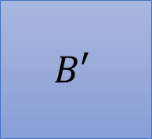













Diagonalization
A is symmetric
$$P^{T}AP=D$$
$$A:n×n$$
ortho
$$λ$$
0
$λ$’
0
$$1$$
0
0
$A$’
0
$A$’’
0
$$B′$$
$$B^{T}AB=$$
$${B′}^{T}A^{′}B′=$$
$$C=$$
sym
ortho
symmetric
symmetric
ortho
$$C^{T}B^{T}ABC=?$$
$$1$$
0
$$λ$$
0
$$1$$
0
$$λ$$
0
0
$${B′}^{T}$$
0
$A$’
0
$$B′$$
0
$${B′}^{T}A^{′}B′$$
$$=$$

Slide 21

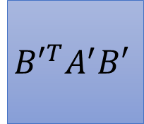











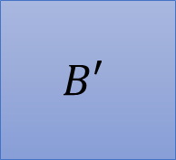





Diagonalization
A is symmetric
$$P^{T}AP=D$$
$$A:n×n$$
$$C^{T}B^{T}ABC=?$$
$${B′}^{T}A^{′}B′=$$
$$1$$
0
$$λ$$
0
$$1$$
0
$λ$’
0
0
$${B′}^{T}$$
0
$A$’
0
$$B′$$
0
$A$’’
$$λ$$
0
$$λ$$
0
ortho
ortho
0
$${B′}^{T}A^{′}B′$$
0
$λ$’
0
$$=$$
$$=$$
$$… C^{T}B^{T}ABC…$$
0
$A$’’
$$=D$$

Slide 22



Diagonalization
Example
$$A=PDP^{T}$$
$$A=PDP^{−1}$$
$$P^{T}AP=D$$
A has eigenvalues λ₁ = 6 and λ₂ = 1,
with corresponding eigenspaces E₁ = Span{[ −1 2 ]^{T}} and
E₂ = Span{[ 2 1 ]^{T}}
orthogonal
⇒ B₁ = {[ −1 2 ]^{T}/√5} and B₂ = {[ 2 1 ]^{T}/√5}

Slide 23
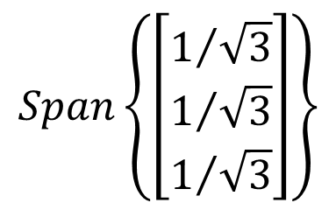

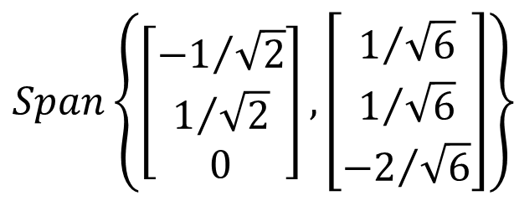


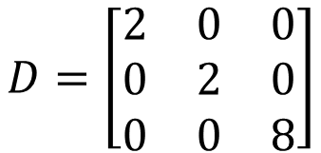

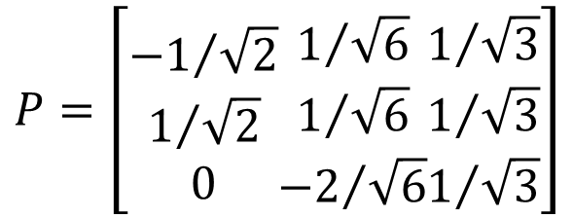
Example of Diagonalization of Symmetric Matrix
$$A=PDP^{−1}$$
$$A=PDP^{T}$$
P is an orthogonal matrix
independent
Gram-
Schmidt
λ₁ = 2
$$Span\left\{\left[\begin{aligned}{−1}/{\sqrt{2}} \\ 1/{\sqrt{2}} \\ 0\end{aligned}\right],\left[\begin{aligned}1/{\sqrt{6}} \\ 1/{\sqrt{6}} \\ {−2}/{\sqrt{6}}\end{aligned}\right]\right\}$$
Eigenspace: $Span\left\{\left[\begin{aligned}−1 \\ 1 \\ 0\end{aligned}\right],\left[\begin{aligned}−1 \\ 0 \\ 1\end{aligned}\right]\right\}$
normalization
λ₂ = 8
Not orthogonal
$$Span\left\{\left[\begin{aligned}1/{\sqrt{3}} \\ 1/{\sqrt{3}} \\ 1/{\sqrt{3}}\end{aligned}\right]\right\}$$
Eigenspace: $Span\left\{\left[\begin{aligned}1 \\ 1 \\ 1\end{aligned}\right]\right\}$
normalization
$$P=\left[\begin{aligned}{−1}/{\sqrt{2}} \\ 1/{\sqrt{2}} \\ 0\end{aligned}\begin{aligned}1/{\sqrt{6}} \\ 1/{\sqrt{6}} \\ {−2}/{\sqrt{6}}\end{aligned}\begin{aligned}1/{\sqrt{3}} \\ 1/{\sqrt{3}} \\ 1/{\sqrt{3}}\end{aligned}\right]$$
$$D=\left[\begin{matrix}2 & 0 & 0 \\ 0 & 2 & 0 \\ 0 & 0 & 8\end{matrix}\right]$$

Slide 24


Diagonalization
P is an orthogonal matrix
A is symmetric
$$P^{T}AP=D$$
$$A=PDP^{T}$$
P consists of eigenvectors
, D are eigenvalues
Finding an orthonormal basis consisting of eigenvectors of A (1) Compute all distinct eigenvalues λ₁, λ₂, 😐, λ_{k} of A.
(2) Determine the corresponding eigenspaces E₁, E₂, 😐, E_{k}.
(3) Get an orthonormal basis B _{i} for each E_{i}.
(4) B = B ₁∪ B ₂∪☹∪ B _{k} is an orthonormal basis for A.

Slide 25















Diagonalization of Symmetric Matrix
$$u=c_{1}v_{1}+c_{2}v_{2}+⋯+c_{k}v_{k}$$
$$u∙v_{1}$$
$$u∙v_{2}$$
$$u∙v_{k}$$
Orthonormal basis
$$D$$
$${\left[T\right]}_{\text{B}}$$
$${\left[v\right]}_{\text{B}}$$
$${\left[T\left(v\right)\right]}_{\text{B}}$$
simple
$$P^{−1}$$
Eigenvectors form the good system
$$P$$
$$B^{−1}$$
$$B$$
Properly selected
Properly selected
$$A=PDP^{−1}$$
$$v$$
$$T\left(v\right)$$
A is symmetric

Slide 26
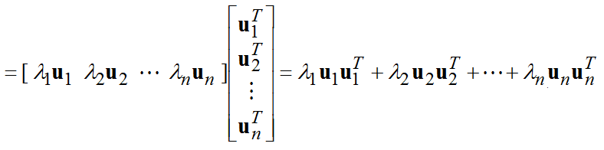





Spectral Decomposition
Orthonormal basis
A = PDP^{T}
Let P = [ u₁ u₂ ☹ u_{n} ] and D = diag[ λ₁ λ₂ ☹ λ_{n} ].
= P[ λ₁e₁ λ₂e₂ ☹ λ_{n}e_{n} ]P^{T}
= [ λ₁Pe₁ λ₂Pe₂ ☹ λ_{n}Pe_{n} ]P^{T} = [ λ₁u₁ λ₂u₂ ☹ λ_{n}u_{n} ]P^{T}
nx1 1xn
$$P_{1}$$
$$P_{2}$$
$$P_{n}$$
$$=λ_{1}P_{1}+λ_{2}P_{2}+⋯+λ_{n}P_{n}$$
$P_{i}$ are symmetric

Slide 27











Spectral Decomposition
Orthonormal basis
A = PDP^{T}
Let P = [ u₁ u₂ ☹ u_{n} ] and D = diag[ λ₁ λ₂ ☹ λ_{n} ].
$$=λ_{1}P_{1}+λ_{2}P_{2}+⋯+λ_{n}P_{n}$$
$$=u_{i}$$
$$=0$$

Slide 28



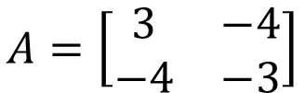



Spectral Decomposition
Example
$$A=\left[\begin{matrix}3 & −4 \\ −4 & −3\end{matrix}\right]$$
Find spectrum decomposition.
$$P_{1}=u_{1}u_{1}^{T}=\left[\begin{matrix}\frac{4}{5} & \frac{−2}{5} \\ \frac{−2}{5} & \frac{1}{5}\end{matrix}\right]$$
Eigenvalues λ₁ = 5 and λ₂ = −5.
An orthonormal basis consisting of eigenvectors of A is
$$B=\left\{\left[\begin{matrix}{−2}/{\sqrt{5}} \\ 1/{\sqrt{5}}\end{matrix}\right],\left[\begin{matrix}1/{\sqrt{5}} \\ 2/{\sqrt{5}}\end{matrix}\right]\right\}$$
$$P_{2}=u_{2}u_{2}^{T}=\left[\begin{matrix}\frac{1}{5} & \frac{2}{5} \\ \frac{2}{5} & \frac{4}{5}\end{matrix}\right]$$
$$u_{1}$$
$$u_{2}$$
$$A=λ_{1}P_{1}+λ_{2}P_{2}$$

Slide 29


Conclusion
Any symmetric matrix
has only real eigenvalues
has orthogonal eigenvectors.
is always diagonalizable
A is symmetric
$$P^{T}AP=D$$
$$A=PDP^{T}$$
P is an orthogonal matrix

Slide 30
Acknowledgement
感謝黃彥鈞同學發現投影片上的錯字

